Slide 1

Start Screen
Search Music
|
Jesus Shall Reign
Ps 6: Chide Me, O LORD, No Longer
Ps 138: With All My Heart, My Thanks I’ll Bring
Ps 114 (NKJV)
On Christ The Solid Rock (Fugue)
The Lord’s Prayer
Christ Is Made the Sure Foundation
The Church’s One Foundation
Jesus, Thy Blood and Righteousness
Doxology
311
8
182
Psalm 114
411
344
327
260
437

Slide 2

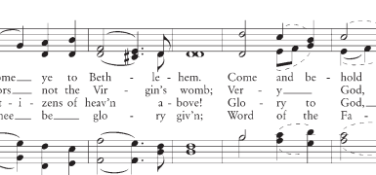
Song Screen
<
O Come All Ye Faithful
<<
>>

Slide 3

Settings Screen
<
O Come All Ye Faithful
Soprano
Alto
Tenor
Bass
<<
>>

